Slide 1

Broome Technology Park
A Sustainable
Economic Future
for Broome County
Informational Recording
Posted on: March 18, 2026
http://www.broometechpark.com
www.theagency-ny.com

Slide 2

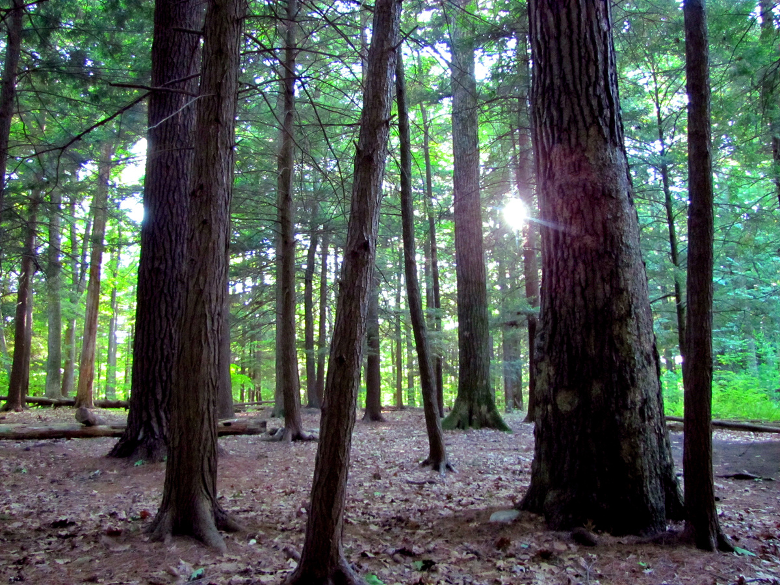
AGENDA
Broome Technology Park
Informational Recording
The Study Process
Why a Broome Technology Park
The Study Area & Concept Plan
Generic Environmental Impact Statement (GEIS) Overview
Summary & Next Steps
We would like to acknowledge and thank our Board of Directors and Empire State Development for their critical support in this important effort.

Slide 3
A Milestone Moment in our Study Process
The release of the draft GEIS marks a milestone in our work to study, analyze, and develop a new large-scale economic development site in Broome County. This has been the culmination of years of work to identify and assess viable locations.
Purpose is not to put a shovel in the ground but rather understand the potential for future development while avoiding unnecessary impacts
The result of our analysis is the draft conceptual plan that we are publishing for review and comment.
All future development must abide by all permitting requirements including local approvals
Notes:
Stacey emphasize we are not building anything.
Here today to inform residents, elected officials, or anyone who may be benefit

Slide 4

Why a Broome Technology Park?

Slide 5

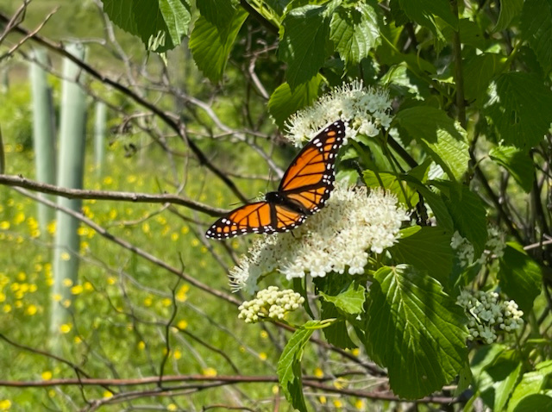
Why a Broome Technology Park?
To support the expansion of manufacturing in NYS.
To create opportunities for new private investment and job creation to retain our young people.
To support the growth of existing manufacturers in the region and stem outward migration.
To attract industries that align with R&D at Binghamton University and are priority sectors in NYS: advanced electronics, semiconductors (supply chain), life sciences, and agricultural products.
Notes:
This park can be a statewide model for sustainability and preserving natural amenities.
Repatriation of American Manufacturing – Onshoring – Add Made in USA sticker? (stacey)

Slide 6
The Study Area Location

Slide 7
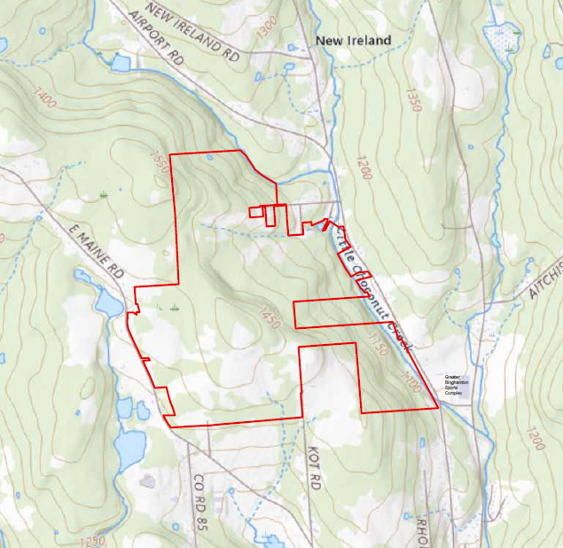
Study Area Properties
In Towns of Maine and Union
Close proximity to I-86/I-81/I-88 and the Greater Binghamton Airport
Visually Buffered from Adjacent Areas
Notes:
Cover the ‘why this location’ in talking points
The IDA evaluated multiple sites to identify areas large enough to accommodate a modern technology park
This analysis found that this site presented the fewest barriers to development, such as slopes and wetlands, and had the most optimal access to necessary transportation and utilities
Today many development projects are growing in size and scale with co-location of complementary businesses therefore requiring a larger site.
Smaller sites and buildings (i.e., old K-Mart Plaza, old BAE, other vacant sites) cannot accommodate this need.
The IDA’s Corporate Park in Conklin is largely full (only 1-2 small parcels with constraints exist)
We selected this site because…
Strong infrastructure
Options for multi-use build-out and adjoining acreage
Proximity to County airport and Interstate exchange
Lack of sufficient sites elsewhere
FAST NY Shovel Ready Fund

Slide 8


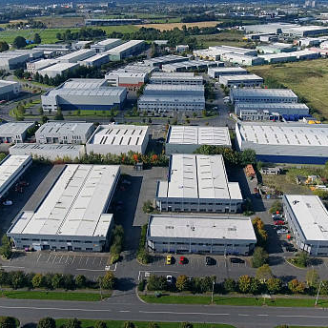
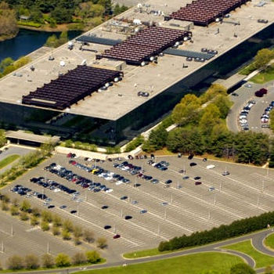

“Old” v “New” Developmental Models
Old Development Model
Takes away local resources and benefits. Profit over people and planet
New Development Model
Gives back and supports the local community and ecosystem
Notes:
Differentiator is this. Most important thing to discuss in the community.
Will have all elements of ‘industrial park’ but designed differently.
Aligns with desires of the Towns to preserve a more natural and rural aesthetic
Designing this with the towns in mind

Slide 9
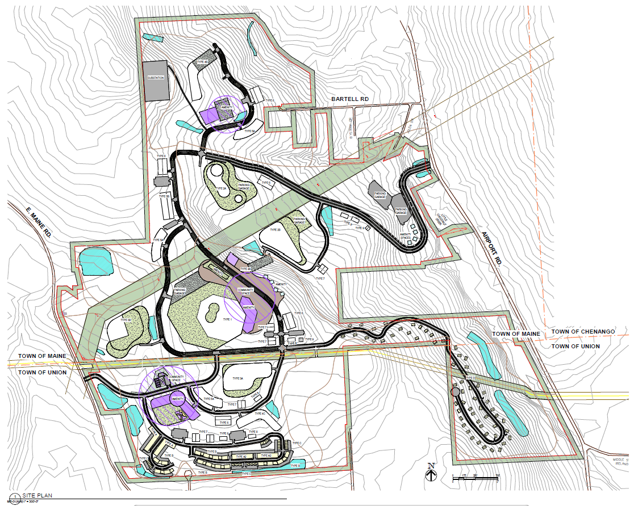
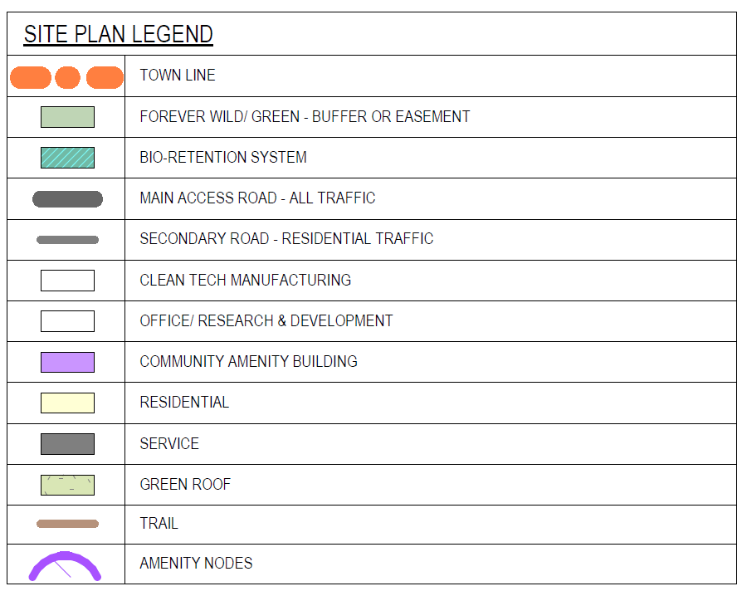
Conceptual Site Plan
Notes:
Stacey
1. This will appear in the GEIS
2. Give a sense of how this can be ultimately lay out
3. This is done to show potential future companies how they can fit
4. This is not set in stone nor will be built tomorrow
5. Gives a sense of what realistically can be put here

Slide 10
GEIS Overview

Slide 11
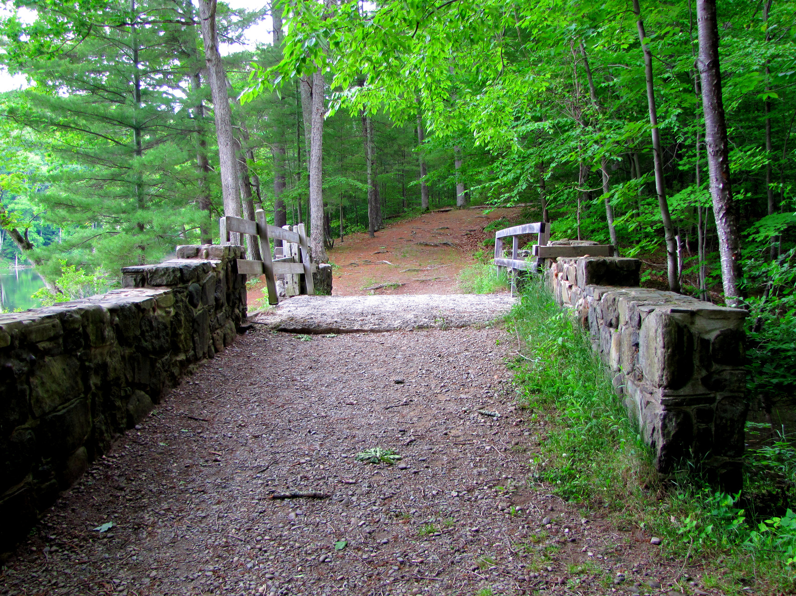
What is a Generic Environmental Impact Statement (GEIS)?
A GEIS:
Identifies potential significant adverse environmental impacts from future projects and corresponding mitigation measures;
Is a broader and more general environmental impact statement that evaluates potential impacts associated with a proposed project at a conceptual level;
Focuses on a larger or more complicated area; and
Is a useful tool for comprehensive, long term planning and implementation over a large or complex area.
Notes:
Not a document that means that shovels will be going into the ground once done. Need permits etc.

Slide 12
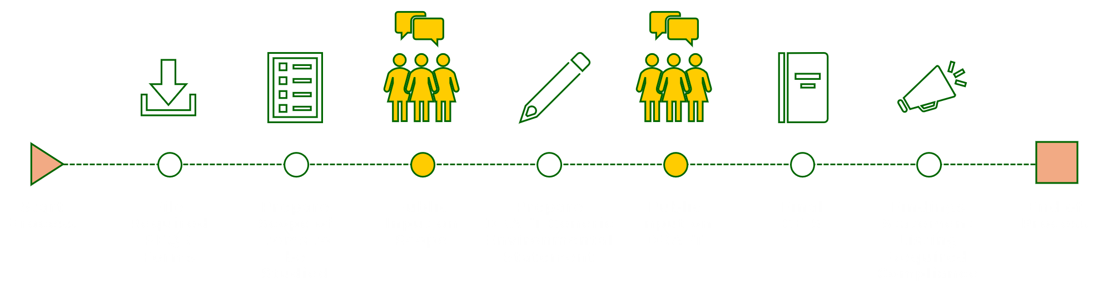
NY State Environmental Quality Review Act (SEQRA) Process
We are Here

Slide 13
What was Studied in our GEIS
Land use, community character, zoning, public policy
Community services
Geology, soils, topography
Natural resources – impact on plants and animals
Surface water resources and wetlands
Stormwater management
Water supply
Sanitary sewer service
Energy & telecommunications
Traffic & transportation
Air quality
Visual
Noise
Socioeconomic conditions and economic impacts
Cultural resources
Notes:
This is what we looked at but you need to go to the full document for what your interest is
Copies will be located at_________ + digitally __________
Explain what you will see in the GEIS
Existing Conditions
Potential Impact
Mitigation measures (if needed)

Slide 14
Brief Summary
Traffic & Transportation
Primary access off Airport Rd.; secondary access/lower volume off East Maine Rd.
Airport Road and connected roads have sufficient capacity to accommodate traffic loads in initial development phases.
Until 60% of the park is built, only minor road improvements are necessary including a turning lane into the park and out of the park
Visual
Most of the area (approximately 92%) would not be able to see the proposed structures at all, and only a small portion (approximately 8%) might be able to see some part of them.
Open Space & Wildlife
Roughly 77% of the total project site will remain preserved as open space and natural areas.
Conceptual development is planned to work with the existing site topography rather than significantly leveling the terrain.
Notes:
Focusing on topic areas where we know people are interested in
Not a stand in for the entire document
Need to go read it

Slide 15
Brief Summary
Economic Impact
At 20-year buildout the Project would support ~7,000 operational jobs, $690 million in earnings, and over $2.3 billion in economic activity.
For the first 20 years there will be approximately 1,500 Construction jobs each year
Community Services
Will increase demand on local services (I.e., police, fire, EMS)
Over a 40-years: Total projected net tax revenues to County, Towns and JC School are estimated at approximately $800 million covering any associated impacts.
Result in a substantial net positive fiscal balance for all affected taxing jurisdictions
Community Benefit Agreement touching on priorities such as enhanced recreation, education, infrastructure, and any other priorities outlined by the communities.
Notes:
Focusing on topic areas where we know people are interested in
Not a stand in for the entire document
Need to go read it

Slide 16
Summary & Next Steps

Slide 17
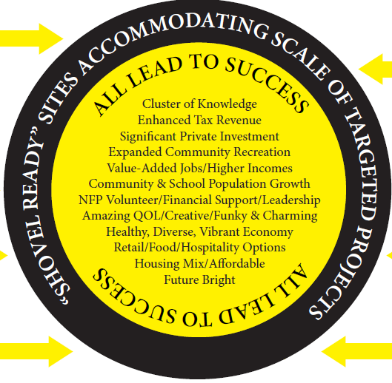
Long-Term Benefits
Income &
Tax Base Growth
Reverse Outmigration
Diverse Job Opportunities
Growth in Local Schools
Retention of Graduates
New Housing Choices
Support for Small Business &
Non-Profit Organizations
Enhanced Recreational
Opportunities
Sustainable Practices
Notes:
Stacey

Slide 18
GEIS Review and Providing Public Comment
Locate the DGEIS at:
Tech Park website: www.broometechpark.com
Agency website: www.theagency-ny.com
Hard copies:
Your Home Public Library, Village of Johnson City
George F. Johnson Memorial Library, Village of Endicott
Comments:
Written comments to The Agency Broome IDA/LDC, 5 South College Drive, Binghamton, NY 13905 with ‘Attention: DGEIS Comments’ in the address block
Electronically at techpark@theagency-ny.com
Close of public comment April 26, 2026
Public Hearing:
6:00pm, April 16, 2026 → Johnson City High School Auditorium
Date extended to May 8.
Date changed to April 23 due to scheduling constraints.
Notes:
Possibly have a form/comment card available with the hard copies?

Slide 19
THANK YOU
Follow the project on: broometechpark.com
Join our email by going to broometechpark.com and hitting the “Join Our Email List” Button
Notes:
Stacey

